Slide 1
Microsoft Windows Azure
In 2008, Microsoft launched a Windows Azure platform to meet the challenges in cloud computing.
This platform is built over Microsoft data centers.
Figure 4.22 shows the overall architecture of Microsoft’s cloud platform.
The platform is divided into three major component platforms.
Windows Azure offers a cloud platform built on Windows OS and based on Microsoft virtualization technology.
Applications are installed on VMs deployed on the data-center servers.
Azure manages all servers, storage, and network resources of the data center.
On top of the infrastructure are the various services for building different cloud applications.
Cloud-level services provided by the Azure platform are presented here.

Slide 2
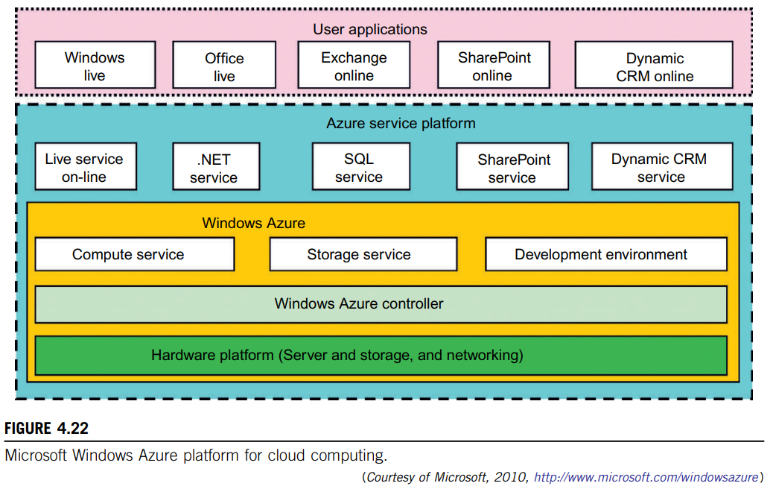

Slide 3
• Live service Users can visit Microsoft Live applications and apply the data involved across multiple machines concurrently.
• .NET service This package supports application development on local hosts and execution on cloud machines.
• SQL Azure This function makes it easier for users to visit and use the relational database associated with the SQL server in the cloud.
• SharePoint service This provides a scalable and manageable platform for users to develop their special business applications in upgraded web services.
• Dynamic CRM service This provides software developers a business platform in managing CRM applications in financing, marketing, and sales and promotions.

Slide 4
All these cloud services in Azure can interact with traditional Microsoft software applications, such as Windows Live, Office Live, Exchange online, SharePoint online, and dynamic CRM online.
The Azure platform applies the standard web communication protocols SOAP and REST.
The Azure service applications allow users to integrate the cloud application with other platforms or third-party clouds.
You can download the Azure development kit to run a local version of Azure.
The powerful SDK allows Azure applications to be developed and debugged on the Windows hosts.

Slide 5
Here, we will describe the programming model of Azure in more detail.
Some key programming components, including the client development environment, SQLAzure, and the rich storage and programming subsystems, are shown in Figure 6.25.
First we have the underlying Azure fabric consisting of virtualized hardware together with a sophisticated control environment implementing dynamic assignment of resources and fault tolerance.
This implements domain name system (DNS) and monitoring capabilities.
When the system is running, services are monitored and one can access event logs, trace/debug data, performance counters, IIS web server logs, crash dumps, and other log files.
This information can be saved in Azure storage.
Note: There is no debugging capability for running cloud applications, but debugging is done from a trace.

Slide 6
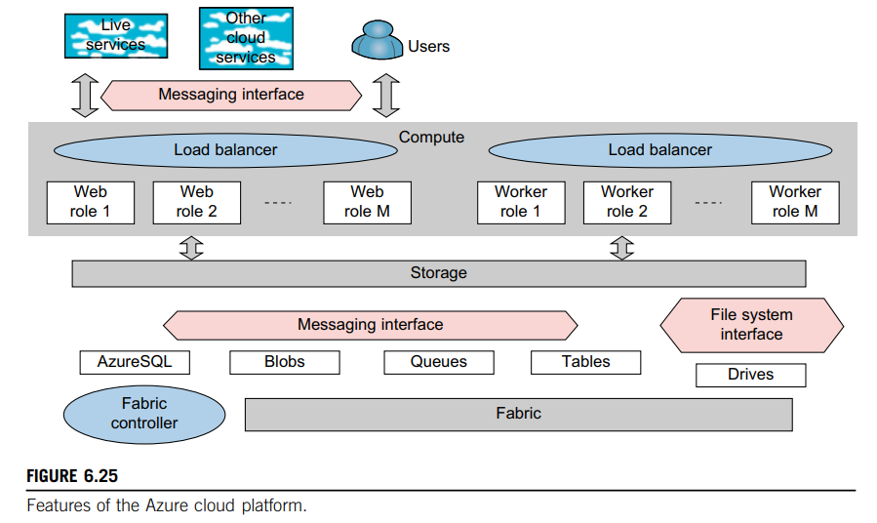

Slide 7
The Azure application is linked to the Internet through a customized compute VM called a web role supporting basic Microsoft web hosting.
Such configured VMs are often called appliances.
The other important compute class is the worker role reflecting the importance in cloud computing of a pool of compute resources that are scheduled as needed.
The roles support HTTP(S) and TCP.
Roles offer the following methods:
• The OnStart() method which is called by the Fabric on startup, and allows you to perform initialization tasks. It reports a Busy status to the load balancer until you return true.
• The OnStop() method which is called when the role is to be shut down and gives a graceful exit.
• The Run() method which contains the main logic

Slide 8
SQLAZURE
The SQLAzure service offers SQL Server as a service.
All the storage modalities are accessed with REST interfaces except for the recently introduced Drives that are analogous to Amazon EBS , and offer a file system interface as a durable NTFS volume backed by blob storage.
NTFS (New Technology File System) – used for storing, organizing, and finding files on a hard disk efficiently.
The REST interfaces are automatically associated with URLs and all storage is replicated three times for fault tolerance and is guaranteed to be consistent in access.
The basic storage system is built from blobs which are analogous to S3 for Amazon.
Blobs are arranged as a three-level hierarchy:
Account → Containers → Page or Block Blobs.
Containers - are analogous to directories in traditional file systems with the account acting as the root.
The block blob - used for streaming data and each such blob is made up as a sequence of blocks of up to 4 MB each, while each block has a 64 byte ID.
Block blobs can be up to 200 GB in size.
Page blobs are for random read/write access and consist of an array of pages with a maximum blob size of 1 TB.

Slide 9
AZURE TABLES
The Azure Table and Queue storage modes are aimed at much smaller data volumes.
Queues provide reliable message delivery and are naturally used to support work spooling between web and worker roles.
Queues consist of an unlimited number of messages which can be retrieved and processed at least once with an 8 KB limit on message size.
Azure supports PUT, GET, and DELETE message operations as well as CREATE and DELETE for queues.
Each account can have any number of Azure tables which consist of rows called entities & columns called properties.

Slide 10
There is no limit to the number of entities in a table and the technology is designed to scale well to a large number of entities stored on distributed computers.
All entities can have up to 255 general properties which are triples.
Two extra properties, PartitionKey and RowKey, must be defined for each entity, but otherwise, there are no constraints on the names of properties—this table is very flexible!
RowKey - designed to give each entity a unique label while
PartitionKey - designed to be shared and entities with the same PartitionKey are stored next to each other; a good use of PartitionKey can speed up search performance.

